Slide 1
Campus Condition Index (CCI)
Texas Higher Education
Coordinating Board
Finance and Resource Planning
Tom Keaton
Director, Finance and Resource Planning

Slide 2
Campus Condition Index (CCI) Comparison
More complete maintenance picture
Clearer definitions
Simplified value calculation
Reduced data entry
Notes:
Working Group meet in the Spring
Added maintenance subcategories and removed $10,000 threshold to provide a more complete maintenance picture (PM and FA)
Refined definitions plus several new terms to help close the reporting gaps previously experienced
Value formula simplified
Reduced data entry - Maintenance reported at the building versus project level

Slide 3
Campus Condition Index (CCI) Proposed Standard
Campus Condition Index
Rating | Good | Fair | Poor
Percent of Value | 0 – 5 | 5 – 10 | > 10
Standard | Meets | Does Not Meet
Notes:
Propose replacing the deferred maintenance standard
Rate an institutions’ ratio as good, fair, or poor
“Good” meets standard for construction projects.
“Fair” and “Poor” ratings require
a plan of action be submitted with the MP2
project presentations to the committee.
Percent of Value: An institution’s E&G Deferred Maintenance divided by its E&G value.

Slide 4
Campus Condition Index (CCI) Standard Calculation
E&G Deferred Maintenance
(E&G NASF) * 1.67 * (Base Rate)
Example
E&G Deferred Maintenance = $50,100
E&G NASF = 5,000
NASF to Gross Conversion = 1.67
Base Rate = $300
$50,100/(5,000 * $300 * 1.67) = 2% = Good
Notes:
Standard based on E&G only
The new formula uses the building’s E&G NASF, 1.67, and the base rate to convert the net to gross.
Simplified value calculation
Utilize a static conversion from Net to Gross (1.67)
Remove Room and Location Adjustment Coefficients
A study determined the effects of excluding the RAC and LAC from the E&G calculations insignificantly increased the values.
The simplified version is intuitive and easily reproduced providing transparency.
For example, assuming the institution has 5,000 E&G NASF on campus and the calculated base rate is $300, the institution would have $2.5 million in E&G value. $50,100 in E&G Deferred Maintenance results in a ratio of 2% or a rating of Good.

Slide 5
Campus Condition Index (CCI) Institution-Wide Calculation
All Deferred Maintenance
(GSF) * 1.25 * (Base Rate)
Example
All Deferred Maintenance = $33,750
GSF = 9,000
Infrastructure Add-on = 1.25
Base Rate = $300
$33,750/(9,000 * 1.25 * $300) = 1%
Notes:
Concern over an imbalance of comparing institution-wide deferred maintenance to E&G value.
The proposal expands the E&G value calculation by using the building gross versus the E&G gross (E&G NASF X 1.67)
Includes a 25% infrastructure add-on
The proposal calls for this ratio to be used for informational purposes only and not as a standard.
For example, assuming an institution has a 9,000 GSF and the base rate is calculated to be $300, the IW value would be $3.375 million for the institution. $33,750 in Total Deferred Maintenance results in a ratio of 1%.

Slide 6
Campus Condition Index (CCI) Base Rate
Separate GAI and HRI rates
Use CPI-U inflation adjustment
Exclusion “Other” facility types
Average (Adjusted Cost / GSF)
For the last 10 Projects
New Construction
Over 50,000 GSF
With E&G Space
Notes:
The proposal calls for
Separate base rates for GAI’s and HRI’s.
And, Adjust for inflation using CPI-U to align with other staff forecasts
Excluding the “Other” facility type projects for GAI
The HRI sector includes all projects, the GAI sector includes general classroom and office.
The calculation uses the 10 latest approved projects.
New construction with E&G space.
Construction and project planning costs divided by the project gross square feet.
These rates are inflation adjusted by project start year and averaged.

Slide 7
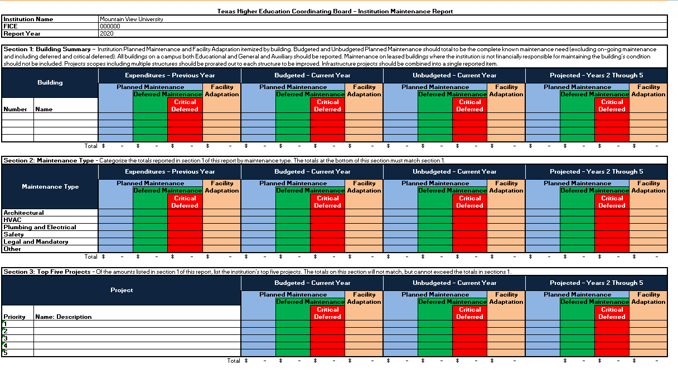
Campus Condition Index (CCI) Institution Maintenance Report (MP2)
Combine MP2 and MP4 into one Report
Collect information by building
Collect additional maintenance types
Notes:
Moving away from the current MP2/MP4 reports.
Discontinue the collection of individual project information
Collect costs by building
Collect additional types of maintenance to provide a complete maintenance picture
See handout of collection report

Slide 8
Campus Condition Index (CCI) Institution Maintenance Report (MP2)
Three Sections
Building
Maintenance Type
Top Five Projects
Notes:
The proposed collection report will have three sections summarized by
Building
Includes all E&G and Non-E&G buildings
Infrastructure projects separated out into one line
Maintenance type
Architectural
HVAC
Plumbing and Electrical
Safety
Legal and Mandatory
Other
Top 5 priority projects.

Slide 9
Campus Condition Index (CCI) Institution Maintenance Report - Continued
Categories
Expenditures – Previous Year
Budgeted – Current Year
Unbudgeted – Current Year
Projected – Years 2 Through 5
Notes:
Each section is categorized by
Expended
current year budgeted
Unbudgeted
projected (2-5 years)

Slide 10
Campus Condition Index (CCI) Institution Maintenance Report - Continued
Subcategories
Planned Maintenance
Deferred Maintenance
Critical Deferred Maintenance
Facility Adaptation
Notes:
To provide the clarity required, we propose expanding the current collection to include two new items.
Subcategorized by
Planned
Deferred
Critical Deferred maintenance
and facility adaptation.
The report does not distinguish between E&G and Non-E&G maintenance.
Maintenance items will be prorated to E&G based on the ratio of E&G Gross to Gross Square Feet in the building.

Slide 11
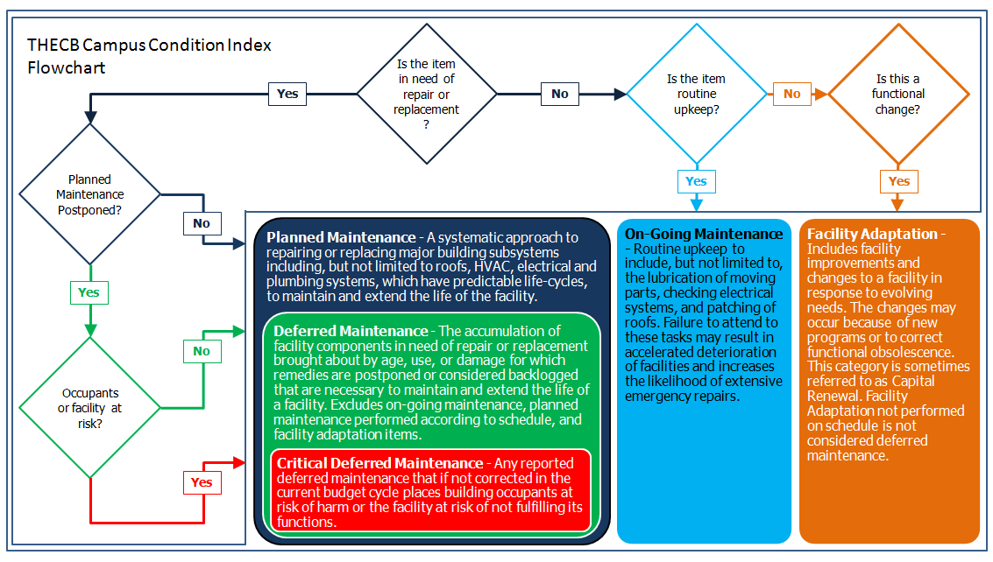
Campus Condition Index (CCI) Maintenance Definitions
Notes:
See handout
The flow chart helps institutions subcategorize maintenance.
The report is designed to collect all but on-going maintenance.
Redefined terms limit deferred maintenance scope to items in disrepair.
Under the new definitions, many planned maintenance items will be inspected and rescheduled if the item is not in disrepair where previously they may have been considered deferred.
From the black diamond, an item is categorized as “in need of repair or replacement”
Items in working order are either on-going maintenance or a functional change and therefore not deferred maintenance.
If the item is not in working order, then the timing is in question. If the condition persists more than a year, it is considered deferred.
Finally, the criticality of the item is scrutinized.

Slide 12
Campus Condition Index (CCI) Deferred Maintenance
Deferred Maintenance – The accumulation of facility components in need of repair or replacement brought about by age, use, or damage for which remedies are postponed or considered backlogged that is necessary to maintain and extend the life of a facility. This includes repairs postponed due to funding limitations. Deferred maintenance excludes on-going maintenance, planned maintenance performed according to schedule, and facilities adaptation items.
Notes:
An item is considered DM if it is
too old
worn out
or damaged
To the point it no longer supports its originally intended function, and
Repair or replacement has been delayed into the following year after the item was discovered.
The E&G portion of the cost of items meeting this definition are included in the standard calculation.

Slide 13
Campus Condition Index (CCI) Critical Deferred Maintenance
Critical Deferred Maintenance – Any deferred maintenance that if not corrected in the current budget cycle places its building occupants at risk of harm or the facility at risk of not fulfilling its functions.
A subset of deferred maintenance
Included in standard calculation
Notes:
The E&G portion of the cost of items meeting this definition are included in the standard calculation.

Slide 14
Campus Condition Index (CCI) On-Going Maintenance
On-going Maintenance – Routine upkeep to include, but not limited to, the lubrication of moving parts, checking electrical systems, and patching of roofs. Failure to attend to these tasks may result in accelerated deterioration of facilities and increases the likelihood of extensive emergency repairs. On-going maintenance is normally funded by an institution’s operating budget.
Notes:
The cost of items meeting this definition are not included in the standard calculation.
And, not reported on the MP2

Slide 15
Campus Condition Index (CCI) Planned Maintenance
Planned Maintenance – A systematic approach to repairing or replacing major building subsystems including, but not limited to roofs, HVAC, electrical and plumbing systems, which have predictable life-cycles, to maintain and extend the life of the facility. This category is sometimes referred to as Facility Renewal or Capital Repair. Planned maintenance is normally funded by an institution’s capital budget.
Notes:
The cost of items meeting this definition are not included in the standard calculation.
But, are reported on the MP2
It is understood some institutions have reported PM as DM in the past. Adding this subcategory, helps to clear up that confusion.

Slide 16
Campus Condition Index (CCI) Facilities Adaptation
Facilities Adaptation – Includes facility improvements and changes to a facility in response to evolving needs. The changes may occur because of new programs or to correct functional obsolescence. This category is sometimes referred to as Capital Renewal.
Notes:
The cost of items meeting this definition are not included in the standard calculation.
But, are reported on the MP2
Adding this subcategory helps to exclude these cost from DM.
And, quantify the state’s needs to maintain usable campuses.

Slide 17
Campus Condition Index (CCI) Examples
Planned Maintenance – Current Year
20-year old building
Built with a 20-year roof
The roof is budgeted to be replaced in the current year
Deferred Maintenance - Unbudgeted
4-year old building
Built with four 30-year elevators
One of the four elevators is not functioning
Planned to be replaced in 26 years
Decided not to repair elevator within the next 5 year
Notes:
These examples demonstrate the type of maintenance requests that fit into the defined categories and subcategories.
The first example, planned maintenance – current year
In need or repair or replacement
Mission and inhabitants are not at risk
Scheduled in the current year
Planned to be completed
Budgeted or funded in the current year’s budget
The second example, deferred maintenance - unbudgeted
In need or repair or replacement
Does not place mission or inhabitants at risk
Not planned or scheduled in the next five years
Unfunded

Slide 18
Campus Condition Index (CCI) Examples - Continued
Critical Deferred Maintenance – Projected
Mold in residential hall placing inhabitants at risk
Low demand for residential halls at the institution
Financially prudent to delay work two years
Decide to close the hall and abate in two years
Facility Adaptation – Expenditures
Building with 20-student capacity classrooms
40-student capacity required to meet institution’s goals
Dean requests adjacent classroom walls be removed
Funded with Planned Maintenance budget
The work was completed last fiscal year
Notes:
The third example is categorized as projected and subcategorized as critical deferred maintenance
In need or repair or replacement
Places inhabitants at risk
Scheduled next year
In the planning phase
Anticipated to be funded
More than 1 year after discovered
The fourth example is categorized as Expenditures and subcategorized as facility adaptation
Completed in the previous year
Expended funds
A desired repair or replacement
Did not place mission or inhabitants at risk

